Slide 1
Graph Machine Learning
towards
aldo marzullo - marzullo@mat.unical.it

Slide 2
Machine Learning (basics)
“relates with the study, design and development of the algorithms that give computers the capability to learn without being explicitly programmed.”
Arthur Samuel
“ML systems learn how to combine input to produce useful predictions on never-before-seen data.”
Wikipedia

Slide 3
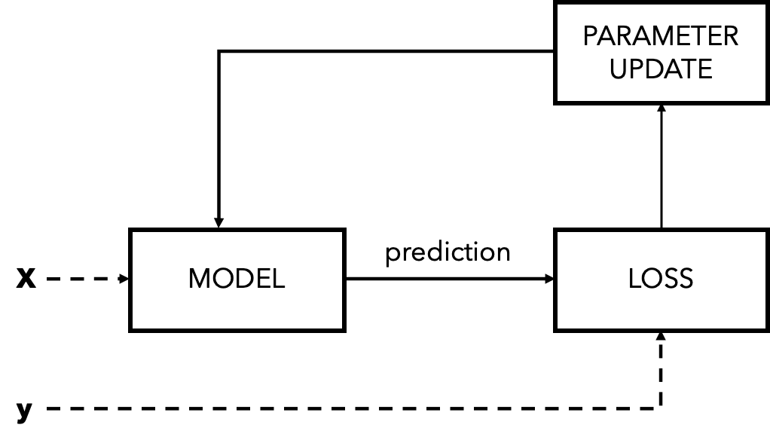
Machine Learning (basics)
Optimization problem: to find a mathematical model able to achieve the best possible performance on a particular task.
Performance is measured using some kind of metric (a.k.a. loss function)

Slide 4

Machine Learning (basics)

Slide 5
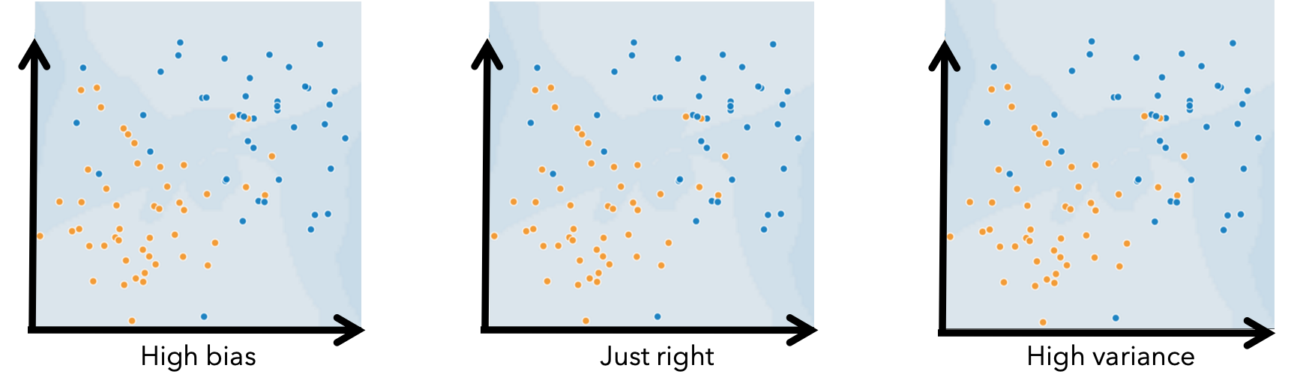
Machine Learning (bias and variance)

Slide 6

Machine Learning (validation)
Memorize is not sufficient: we need to learn
The following conditions should be satisfied:
the dataset should be “large enough”
Test set and Training set should be taken from the same distribution

Slide 7
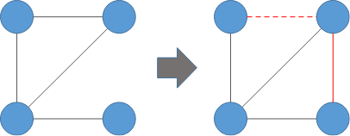
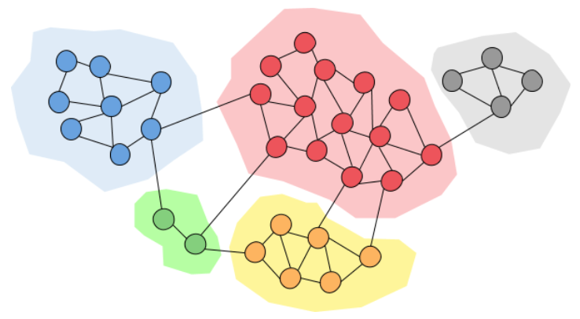
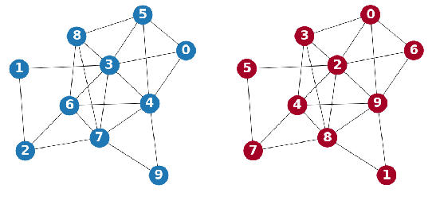
Graph Machine Learning (task)
Missing link prediction (Using Edge Embedding)
Community detection
(Using Node Embedding)
Graph similarity/clustering
(Using Graph Embedding)

Slide 8
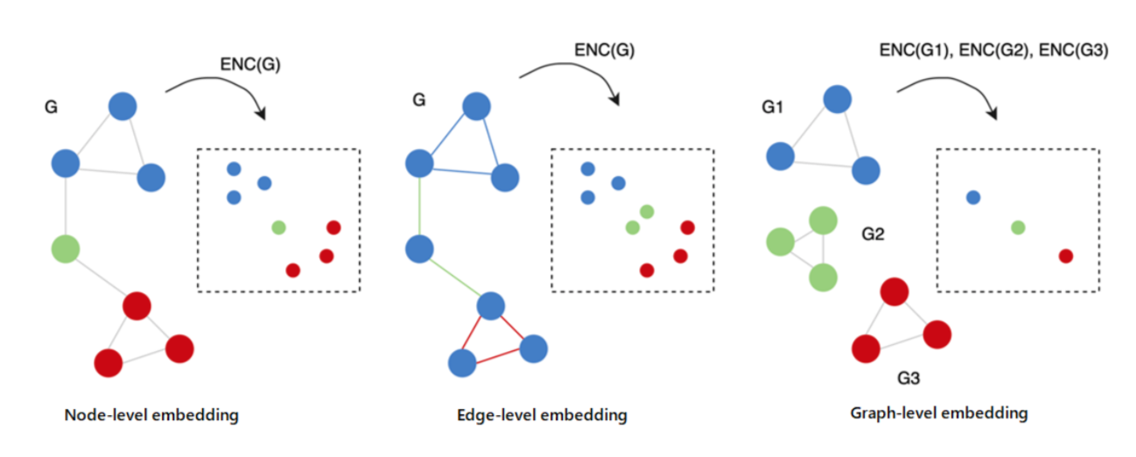
The generalized graph embedding problem
Learn a function F mapping an instance of the problem to a compact (low-dimensional) and meaningful representation
Notes:
representation learning (network embedding) is the task that aims to learn a mapping function f: G -> R^d from a discrete graph to a continuous domain. Function will be capable of performing a low-dimensional vector representation such that the properties (local and global) of the graph are preserved

Slide 9
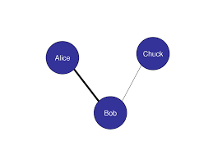
A Straightforward Approach to apply Machine Learning on Graph
In «classical» machine learning applications, a common way to process the input data is to build a set of features. For a node classification task, we compute a set of metrics or known features to generate the feature vector
Feature engineering
NodeId | Node Degree | … | Age
Alice | 0.9 | 0.12 | 28
.. | 0.20 | 0.88 | …
Bob | 0.25 | 0.76 | 31
Node Attributes: We know that the nodes in a graph represent entities and these entities have their own characteristic attributes (Age, Sex, Gender, Average Consumption, etc..).
Local Structural Features: Node features like degree (count of adjacent nodes), mean of degrees of neighbor nodes, number of triangles a node forms with other nodes, etc.

Slide 10


A Straightforward approach to apply Machine Learning on Graph - Limitation
Easy to implement
Useful when we have strong prior knowledge
only consider local node features
do not consider the semantic (context)

Slide 11
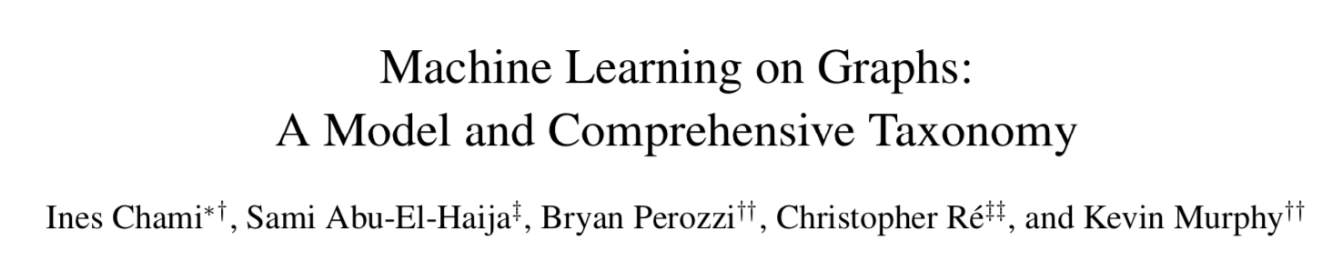
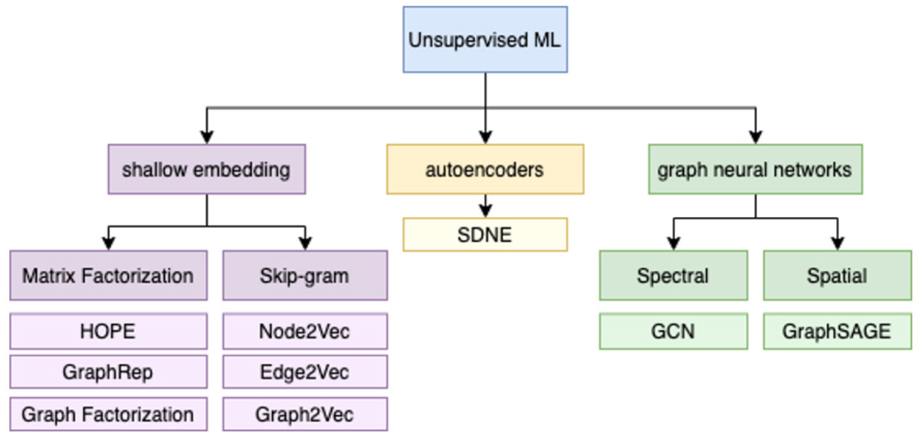
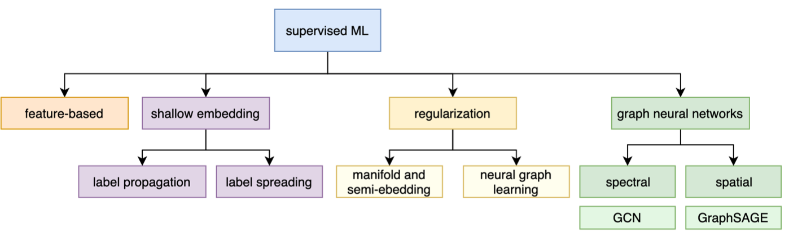
Unsupervised Graph Embedding Algorithms

Slide 12
Unsupervised Graph Embedding Algorithms

Slide 13
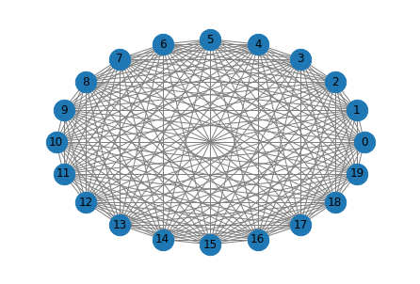
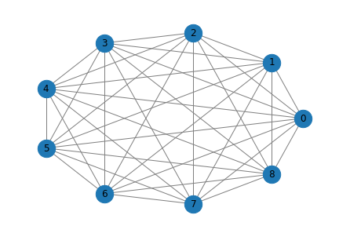
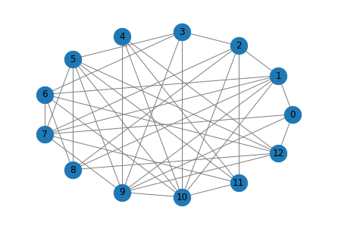
Shallow Embedding Methods
They can only return a vectorial representation of the data they learned during the fit_transform procedure.
They are not able to generalize the function to unseen graphs
G1
G2
G3
graph_list = [G1,G2,G3] graph2Vector.fit_transform(graphs_list, d) embedding = graph2Vector.get_embedding()
GraphId | Dim 1 | Dim 2 | … | Dim d
G1 | 0.9 | 0.12 | … | 0.32
G2 | 0.20 | 0.88 | … | 0.11
G3 | 0.25 | 0.76 | … | 0.09
embedding =

Slide 14
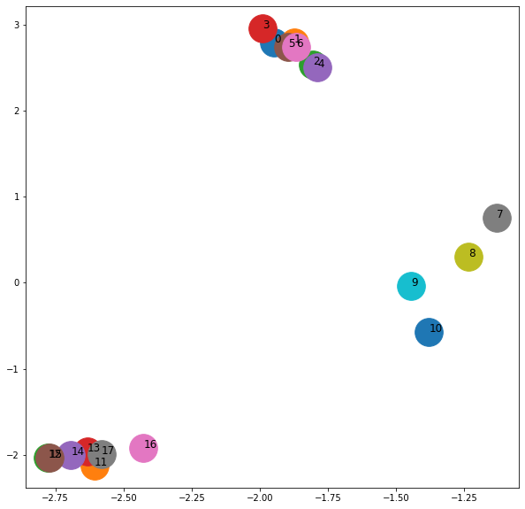
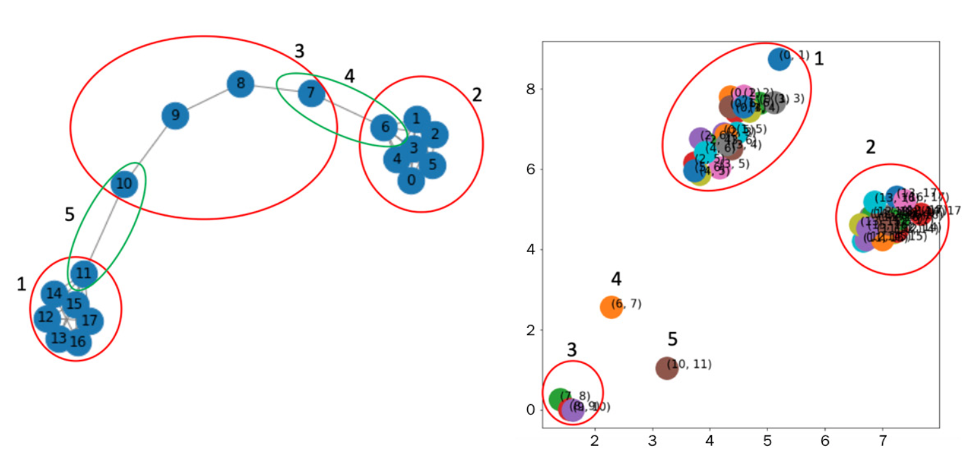
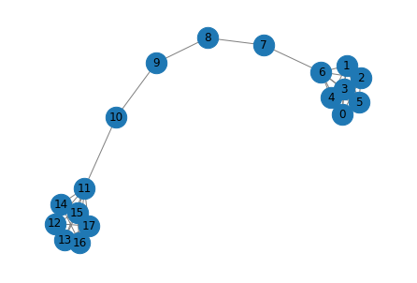
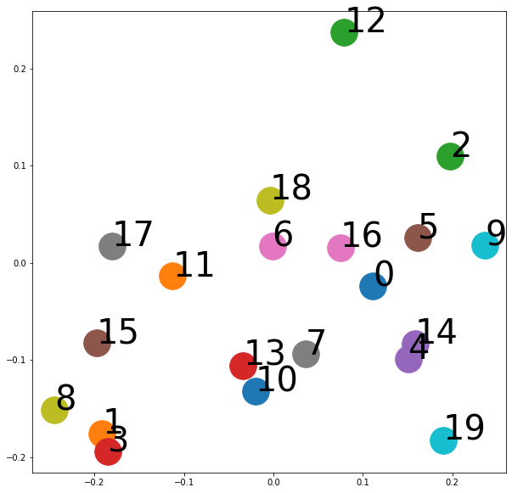
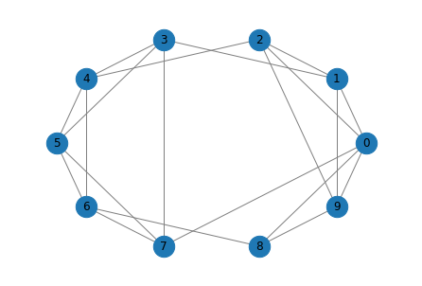
Skip-gram based embedding algorithms– Node2Vec, Edge2Vec, Graph2Vec
Node2Vec
Edge2Vec
2
3
3
2
1
1
…
Graph2Vec
…

Slide 15
Matrix Factorization
Objective: decompose a matrix into constituent parts
Why? constituent parts are “simpler” (e.g. less noisy)
Let W ∈ R^{m x n} be the input data. Matrix Factorization decomposes W ≃ V x H (with V ∈ R^{m x d} and H ∈ R ^{d x n}, d = number of dimension of the embedding space)
V and H are learnt by optimizing a loss function (depending on the specific problem). In the general formulation:
min II W - VH ||²_{F}

Slide 16
Matrix Factorization: Higher-Order Proximity Preserved Embedding (HOPE)
HOPE is designed to preserve higher-order proximity in the embedding space
First order proximity: W_{ij} if (i,j) ∈ E; 0 otherwise
Second order proximity: W_{ij} ☉ W_{jk} if (i,j) ∈ E and (j,k) ∈ E
HOPE optimizes the following problem:
L = || S - VH ||²_{F}
where S ∈ R ^{m x n} is a similarity matrix and V ∈ R^{m x d} and H ∈ R ^{d x n} are the two embedding matrices representing a d-dimensional embedding space.
Notes:
Second or higher order proximity captures the k-hop transition from a node i to a node k

Slide 17
Matrix Factorization: Higher-Order Proximity Preserved Embedding (HOPE)
How to define the similarity matrix S?
Adamic-Adar method:
S = ADA
where A is the adjacency matrix of the graph and D is a diagonal matrix computed as D_{ii} = 1 / ∑_{j}(A_{ij} + A_{ji})
Other formulation of S includes Katz index, Rooted PageRank, Common Neighbours
Notes:
Second or higher order proximity captures the k-hop transition from a node i to a node k

Slide 18
Unsupervised Graph Embedding Algorithms

Slide 19
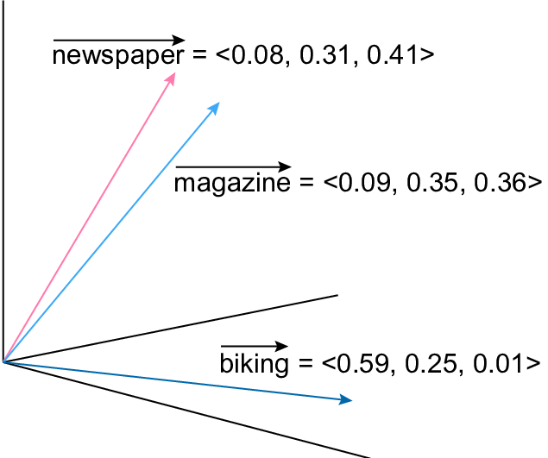
Skip-gram based embedding algorithms
Skip-gram architecture was created for «word embedding» problem also known as Word2Vec
For a given word we want to build a vectorial representation in a d dimensional space
Skip-gram Node2Vec uses the same logic BUT instead of words we have nodes

Slide 20
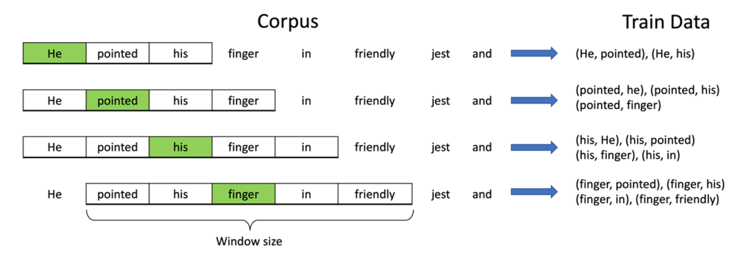
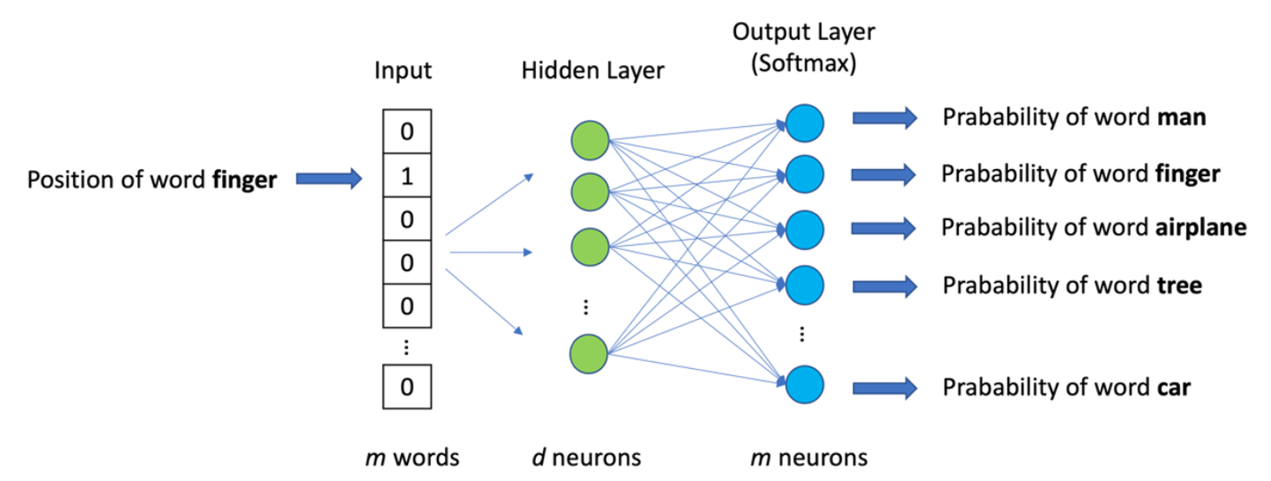
Skip-gram based embedding algorithms
Step 1. Dataset Generation
Step 2. Model Training
Notes:
Word2Vec is a shallow, two-layer neural network that is trained to reconstruct linguistic contexts of words. The objective of the word2vec model is to produce word representation (vectors) given a text corpus.

Slide 21
Skip-gram based embedding algorithms
Step 3. Embedding Extraction
Input
Hidden Layer
0
1
0
0
0
0.1
Position of word finger
0.4
0.6
…
…
1.1
0
m words
d neurons
Word | Dim 1 | Dim 2 | Dim 3 | … | Dim d
Finger | 0.1 | 0.4 | 0.6 |  | 1.1

Slide 22
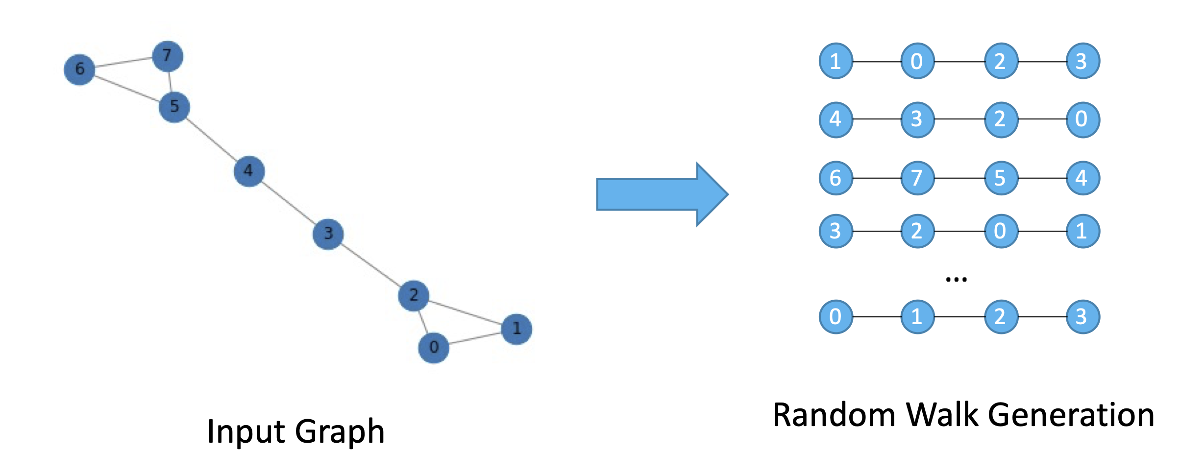
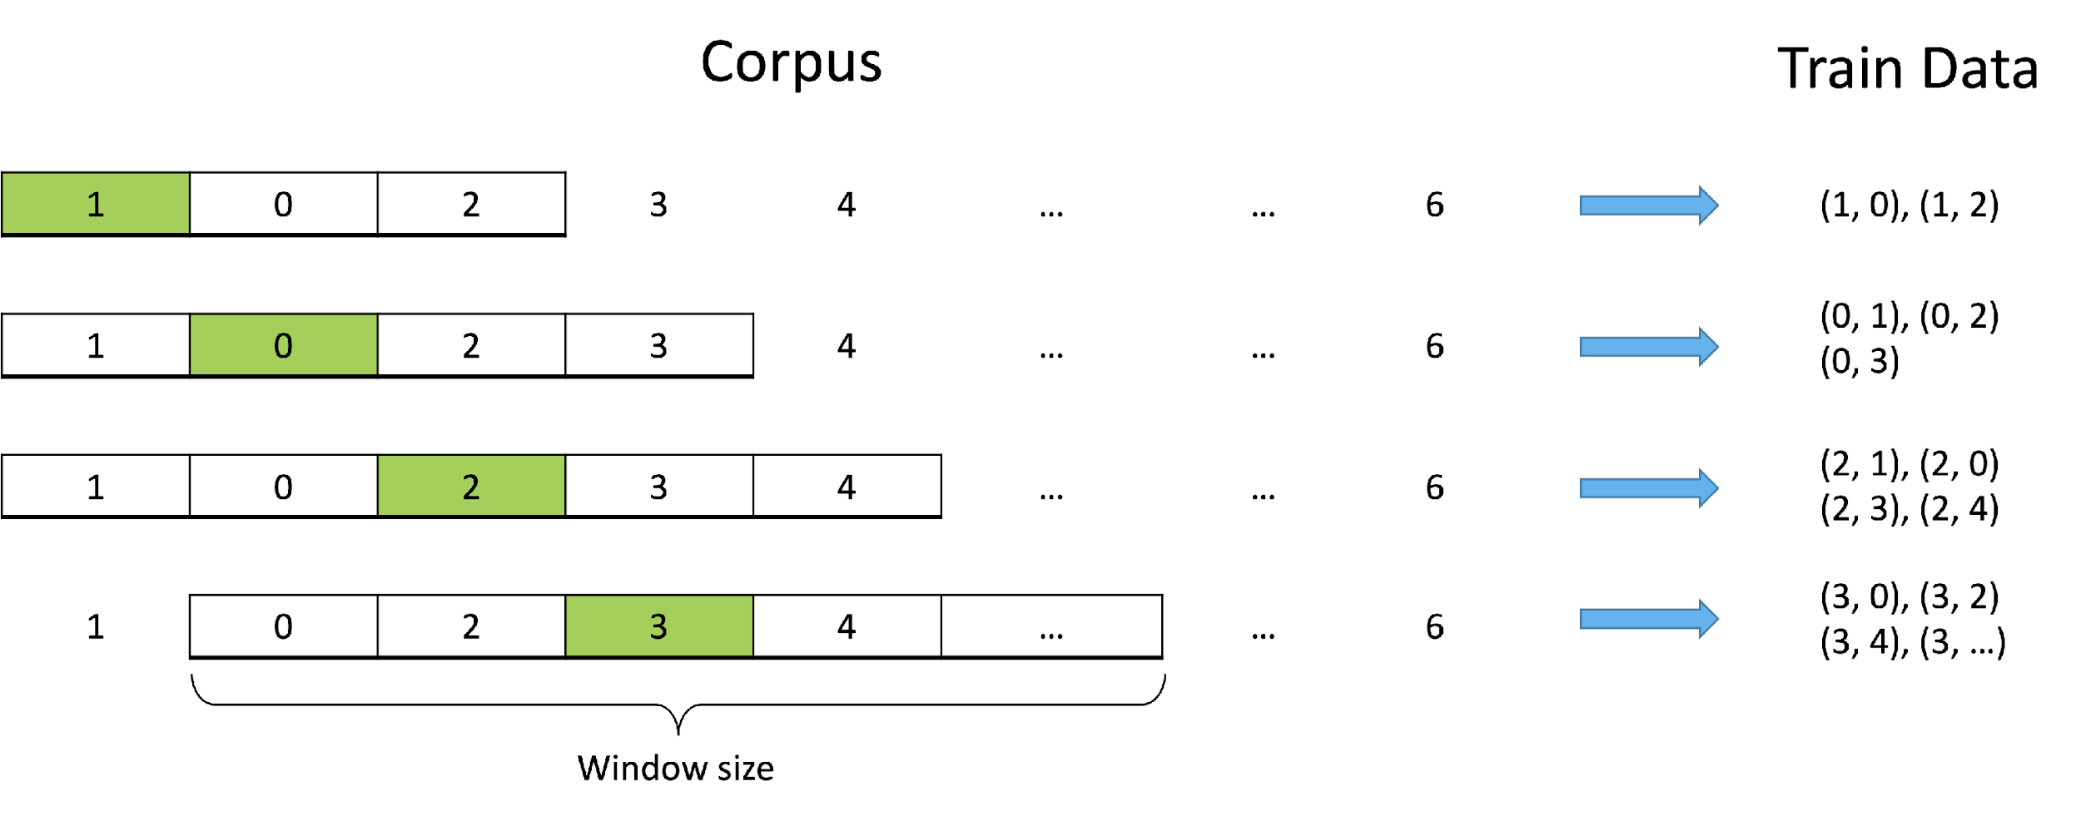
Skip-gram based embedding algorithms – Node2Vec
Step 0. Random Walk Generator
Step 1. Dataset Generation

Slide 23
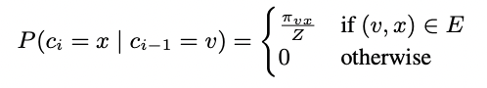
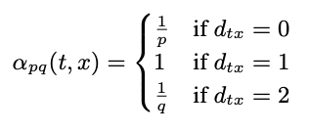
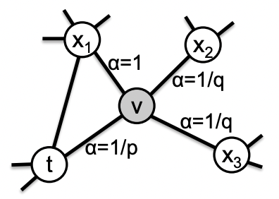
Skip-gram based embedding algorithms – Node2Vec
The following formula defines the probability during the random walk to go from v to x
where πvx is the weight associated to the link (v, x).
For unweighted graph, the probability is governed by two parameters p,q
p = probability for the walk to get back to the previous node
q = probability for the walk to pass through a previously unseen part of the graph
Notes:
Node2Vec introduces the following formula for determining the probability of moving to the node x given that you were previously at the node v. Where z is the normalization constant, and πvx is the unnormalized transition probability between nodes x and v. Clearly, if there is no edge connecting x and v, then the probability will be 0, but if there is an edge, we identify a normalized probability of going from v to x. The paper states that the easiest way to introduce a bias to influence the random walks would be if there was a weight associated with each edge. However, that wouldn’t work in the case of unweighted networks. To resolve this, the authors introduced a guided random walk governed by two parameters p and q. p indicates the probability of a random walk getting back to the previous node, and q indicates the probability that a random walk can pass through a previously unseen part of the graph.
question: increase the probability to go back to the prevous node or go through new parts of the graph? (local vs global)

Slide 24
Skip-gram based embedding algorithms – Node2Vec
Step 3. Embedding Extraction
Input
Hidden Layer
0
1
0
0
0
0.1
Position of Node 2
0.4
0.6
…
…
1.1
0
m nodes
d neurons
NodeId | Dim 1 | Dim 2 | Dim 3 | … | Dim d
Node2 | 0.1 | 0.4 | 0.6 |  | 1.1

Slide 25
Skip-gram based embedding algorithms – Node2Vec
Step 3. Embedding Extraction
Input
Hidden Layer
0
1
0
0
0
0.1
Position of Node 2
0.4
0.6
import networkx as nx from node2vec import Node2Vec node2vec = Node2Vec(G, dimensions=d) model = node2vec.fit(window=10) embeddings = model.wv
…
…
1.1
0
m nodes
d neurons
NodeId | Dim 1 | Dim 2 | Dim 3 | … | Dim d
Node2 | 0.1 | 0.4 | 0.6 |  | 1.1
Notes:
https://towardsdatascience.com/complete-guide-to-understanding-node2vec-algorithm-4e9a35e5d147

Slide 26
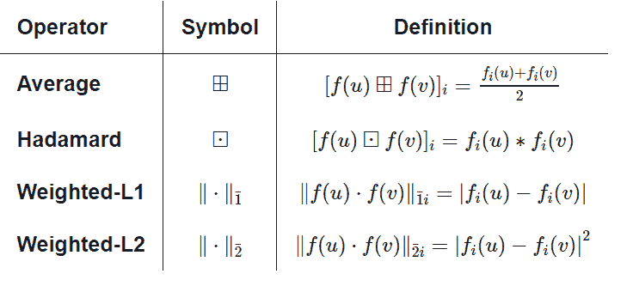
Edge2Vec
1
2
E(Embedding(Node 1), Embedding(Node 2))
import networkx as nx from node2vec import Node2Vec node2vec = Node2Vec(G, dimensions=d) model = node2vec.fit(window=10) embeddings = model.wv from node2vec.edges import HadamardEmbedder embedding = HadamardEmbedder(keyed_vectors=model.wv)
Notes:
To address the above problems, edge2vec was developed to consider edge semantics when generating node sequence using a random walk strategy

Slide 27
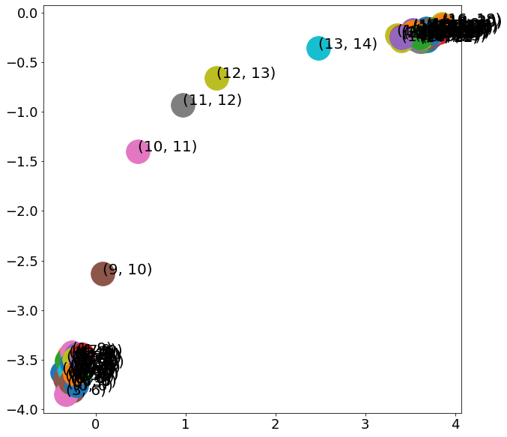
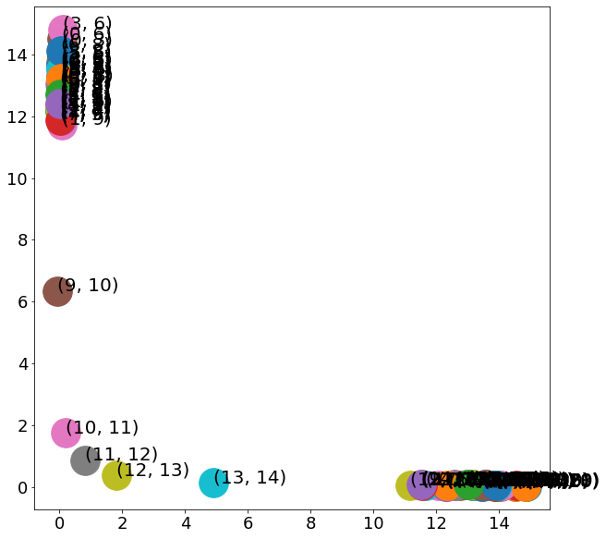
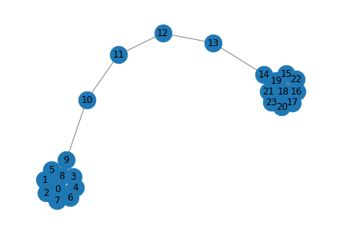
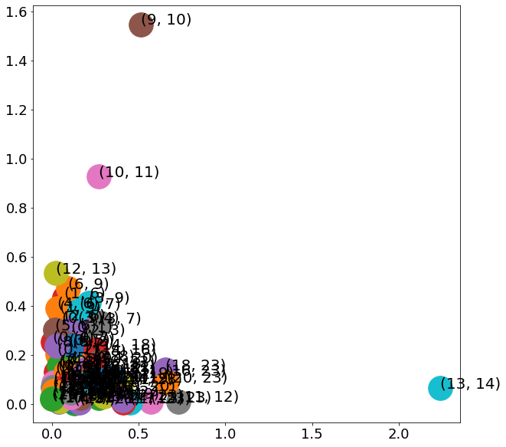
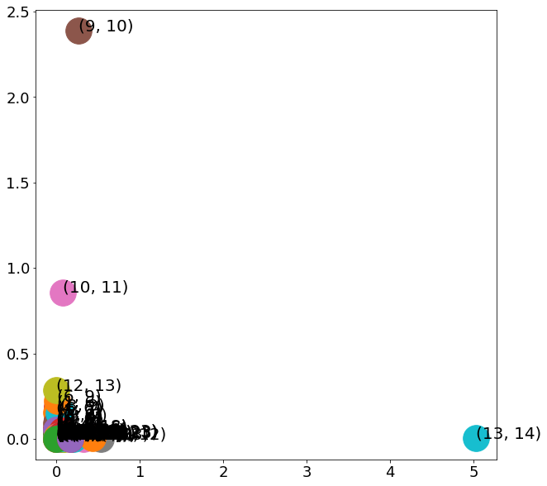
Edge2Vec
AverageEmbedder
HadamardEmbedder
WeightedL1Embedder
WeightedL2Embedder

Slide 28
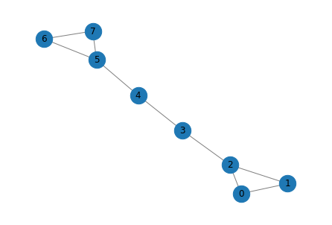
Skip-gram based embedding algorithms – Graph2Vec
Input Graphs
Training Set
(
)
…
(
)
G1,
G1,
Subgraph Generation
G1
…
…
…
(
)
…
(
)
Gm,
Gm,
Subgraph Generation
Gm

Slide 29
Skip-gram based embedding algorithms – Graph2Vec
Output Layer
(Softmax)
Hidden Layer
Input
Prabability of explorting Node₁
0
1
0
0
0
Position of Graph G2
Prabability of explorting Node₂
Prabability of explorting Node₃
Prabability of explorting Node₄
…
…
…
0
Prabability of explorting Node_{p}
m graphs
d neurons
total-nodes neurons

Slide 30
Skip-gram based embedding algorithms – Graph2Vec
Input
Hidden Layer
0
1
0
0
0
0.1
Step 3. Embedding Extraction
Position of Graph 2
0.4
0.6
…
…
1.1
0
m graphs
d neurons
GraphId | Dim 1 | Dim 2 | Dim 3 | … | Dim d
Graph2 | 0.1 | 0.4 | 0.6 |  | 1.1

Slide 31
Unsupervised Graph Embedding Algorithms

Slide 32
Graph Neural Networks: Intuition
Original Graph
Node representation

Slide 33
Graph Neural Networks: Intuition
GNN
Node representation
Node representation

Slide 34
Graph Neural Networks: Intuition
GNN
Loss function
input
output

Slide 35
Unpacking Graph Neural Networks: Neural Message Passing
A
B
C

Slide 36
Unpacking Graph Neural Networks: Neural Message Passing
A
C
B
h^{t-1}
C
current state
A
B
current neighbor states

Slide 37

Unpacking Graph Neural Networks: Neural Message Passing
A
C
B
h^{t-1}
C
current state
A
A
f( )
B
B
f( )
current neighbor states
prepare a “message”

Slide 38

Unpacking Graph Neural Networks: Neural Message Passing
A
C
B
h^{t-1}
C
current state
A
A
f( )
B
B
f( )
current neighbor states
prepare a “message”
summarize messages

Slide 39

Unpacking Graph Neural Networks: Neural Message Passing
A
C
B
h^{t-1}
C
current state
A
A
f( )
B
B
f( )
current neighbor states
prepare a “message”
summarize messages
C
h^{t}
current state

Slide 40
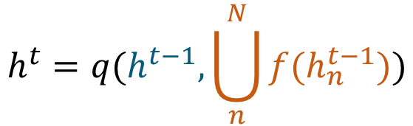
Unpacking Graph Neural Networks: Neural Message Passing
A
C
B
h^{t-1}
C
current state
A
A
f( )
B
B
f( )
current neighbor states
prepare a “message”
summarize messages
C
h^{t}
current state

Slide 41

Unpacking Graph Neural Networks: Neural Message Passing

Slide 42
Unpacking Graph Neural Networks: Neural Message Passing

Slide 43
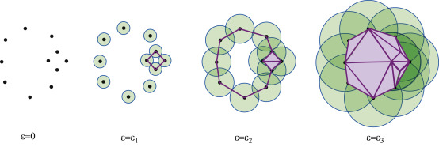
Unpacking Graph Neural Networks: Neural Message Passing

Slide 44

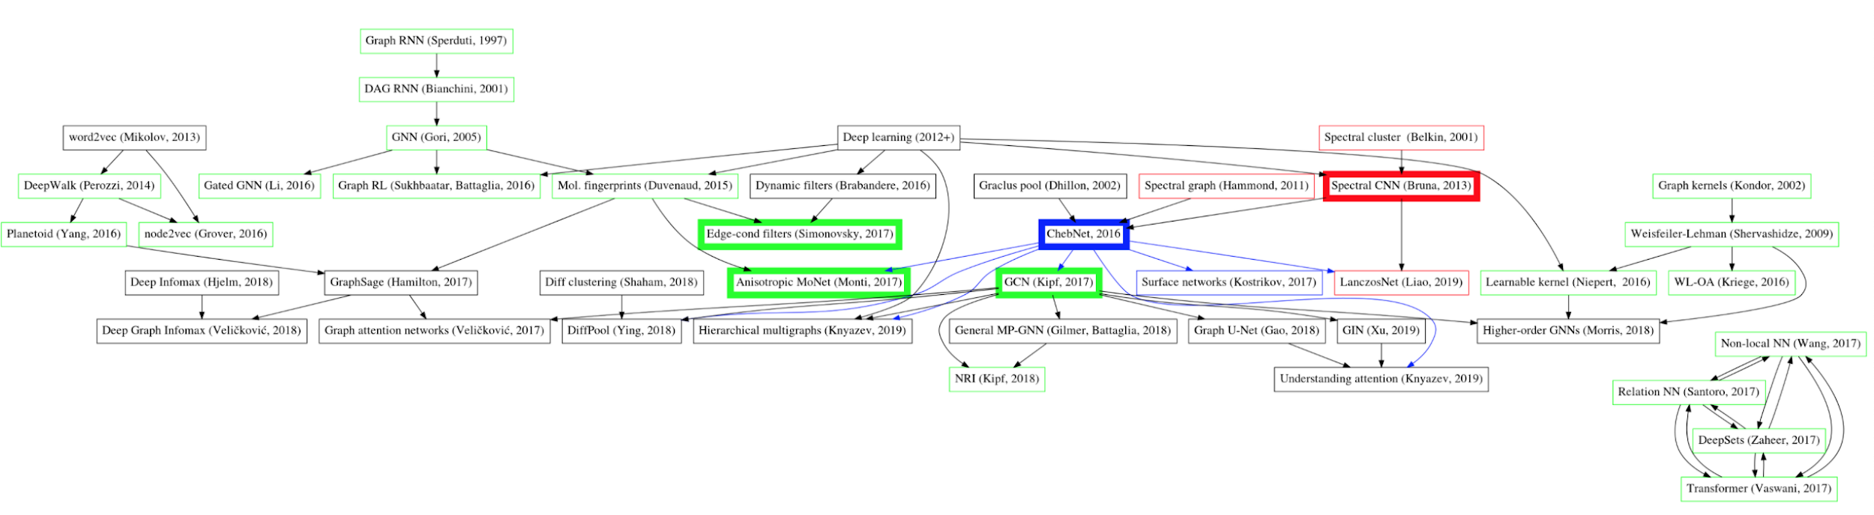

Slide 45

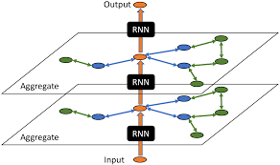
Gated Graph Neural Network (Li et al. 2016)

Slide 46
Gated Graph Neural Network (Li et al. 2016)
improves the original formulation
deals with sequences (i.e. time)
problematic for large graphs

Slide 47
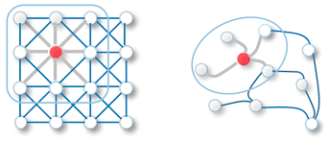
Graph Convolution

Slide 48
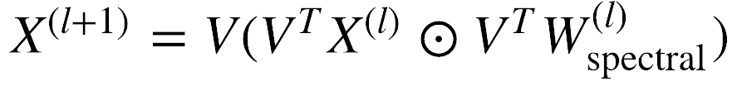
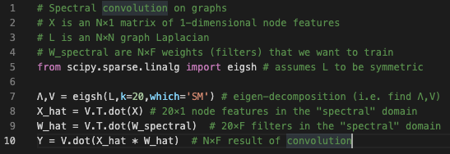
Spectral Graph Convolution (Bruna et al. 2014)
Notes:
Spectral analysis of graphs has been useful for graph clustering, community discovery and other mainly unsupervised learning tasks.
One of the first variation of the message passing idea comes from Bruna et al. who combined spectral analysis with convolutional neural networks (ConvNets) giving rise to spectral graph convolutional networks.
While “spectral” may sound complicated, for our purpose it’s enough to understand that it simply means decomposing a signal/graph into a combination of simple elements. These simple elements are usually orthogonal, i.e. mutually linearly independent, and therefore form a basis.
When we talk about “spectral” in signal/image processing, we refer to the Fourier Transform, which allows to represent a signal as a sum of “waves”. When we talk about graphs “spectral” implies eigen-decomposition of the graph Laplacian L. You can think of the the graph Laplacian L as an adjacency matrix A normalized in a special way, whereas eigen-decomposition is a way to find those elementary orthogonal components that make up our graph.
Intuitively, the graph Laplacian shows in what directions and how smoothly the “energy” will diffuse over a graph if we put some “potential” in node i.

Slide 49
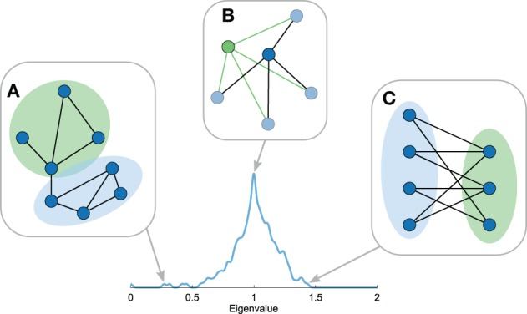
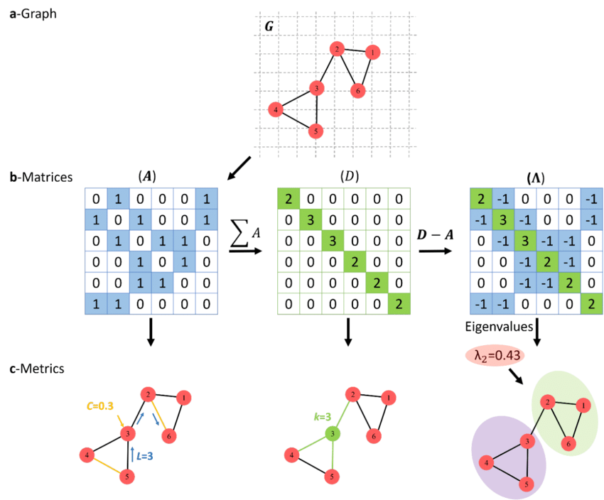
Graph Laplacian (quick jump)

Slide 50
Spectral Graph Convolution (Bruna et al. 2014)
solid theoretical foundations
not inductive
not suitable for large graphs

Slide 51
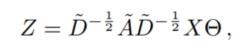
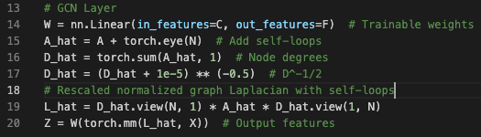
Graph Convolutional Network (Kipf et al. 2016)

Slide 52
Graph Convolutional Network (Kipf et al. 2016)
simplest variant of GNN
less parameters compared to previous variants (e.g. ChebNet)
not inductive
not suitable for large graphs
[1] https://tkipf.github.io/graph-convolutional-networks/
[2] https://www.inference.vc/how-powerful-are-graph-convolutions-review-of-kipf-welling-2016-2/

Slide 53
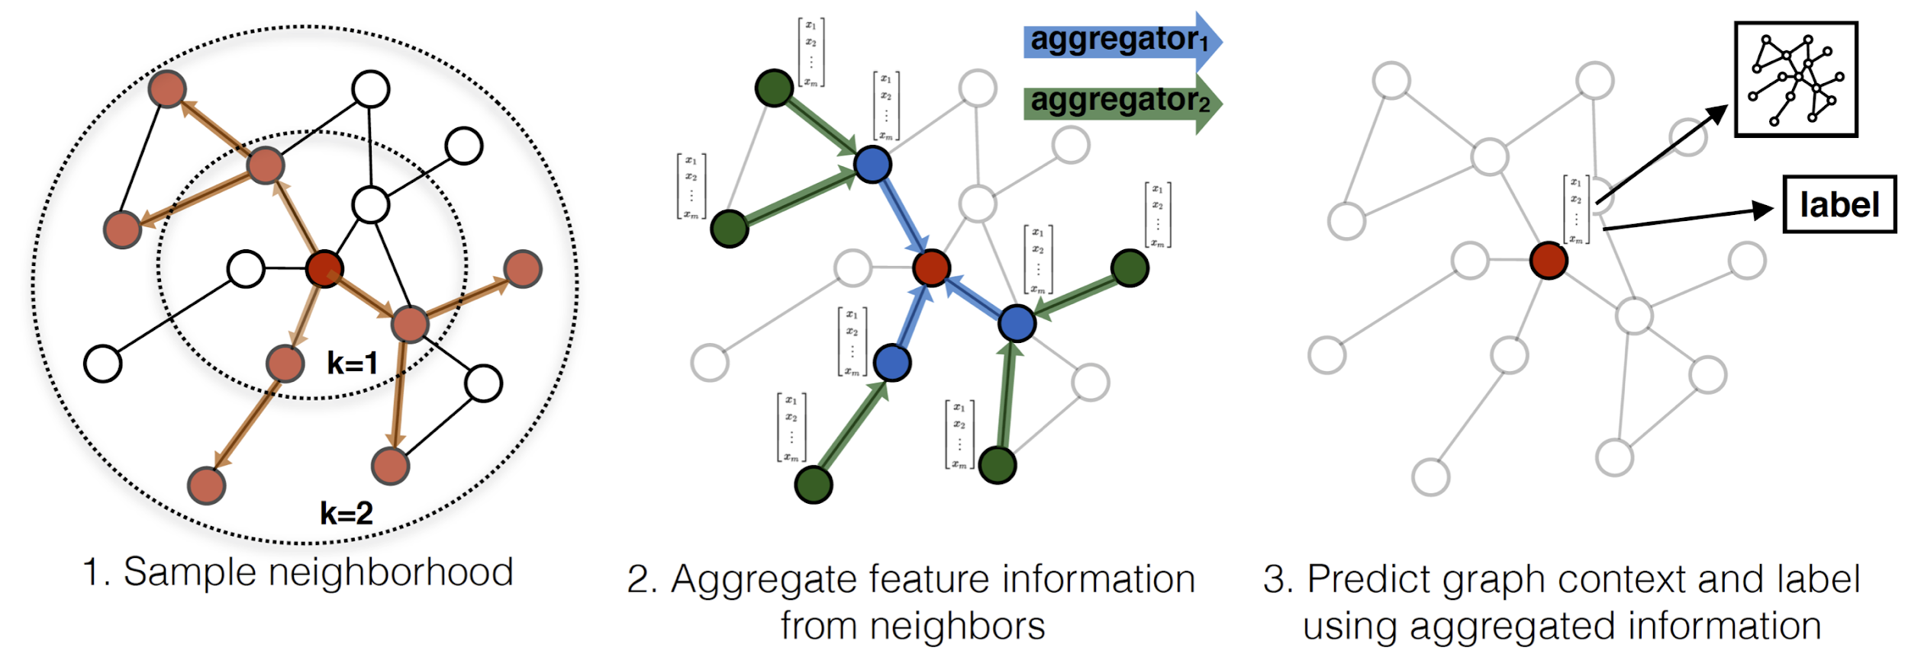
Graph SAmpling and aggreGatE (Hamilton et al. 2017)
Neighbor sampling: how many ”hops” to consider (neighbors of neighbors)
Aggregation: merge the node features (according to certain criteria)
Prediction: each node is equipped with a simple neural networks which predicts the new representation

Slide 54
Graph SAmpling and aggreGatE (Hamilton et al. 2017)
Neighbor sampling: how many ”hops” to consider (neighbors of neighbors)
Aggregation: merge the node features (according to certain criteria)
Prediction: each node is equipped with a simple neural networks which predicts the new representation
A
NN
F
B
2-hops
1-hop
NN
A
F
A
target
representation
NN
B
C
1-hop
2-hops

Slide 55
Graph SAmpling and aggreGatE (Hamilton et al. 2017)
scalable to large graphs
inductive
fails at capturing simple structures
still dependent on k (hops)
[1] Anisotropic, Dynamic, Spectral and Multiscale Filters Defined on Graphs, B. Kniazev
[2] Xu, K., Hu, W., Leskovec, J., & Jegelka, S. (2018). How powerful are graph neural networks?
[3] Can Graph Neural Networks Count Substructures? Z. Chen et al.

Slide 56
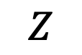
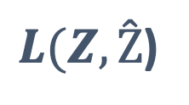
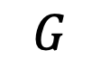
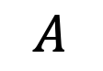
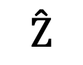
Training GNNs
SUPERVISED
A
GNN
B
C

Slide 57






Training GNNs
UNSUPERVISED
A
B
C
GNN

Slide 58


Training GNNs
SEMI-SUPERVISED
A
B
C
GNN

Slide 59

Correct and smooth!
Correct & Smooth exploits the pattern that adjacent nodes tend to have the same labels and similar features, a concept called homophily
Notes:
Graph data structures and GNNs are difficult to scale to large data [1, 6] and are sufficiently different from standard supervised learning toolkits that teams would need to undergo a time-consuming and expensive process to adopt them. As a result, even if data does have a clear graph structure, it is often ignored or included in the form of row-level hand-tuned features like node degree or graphlet.
Using a recent graph ML algorithm called Correct & Smooth (C&S) [1], we can rival or outperform GNNs using a post-processing module that sits on top of your existing supervised classifier.
Once we have a predicted probability distribution over classes from a supervised learner, C&S first “corrects” errors on test nodes by using error from predictions on training nodes, and then “smooths” the predictions on the test data by incorporating nearby ground truth training labels.

Slide 60

Correct and smooth!
Correct & Smooth exploits the pattern that adjacent nodes tend to have the same labels and similar features, a concept called homophily
train a base classifier (BC)
compute the BC’s prediction errors on the train set (residual errors)
intuition! errors are expected to be positively correlated for neighboring nodes (this means we may know how much wrong is BC)
use this knowledge to correct the errors on the test set
Notes:
Graph data structures and GNNs are difficult to scale to large data [1, 6] and are sufficiently different from standard supervised learning toolkits that teams would need to undergo a time-consuming and expensive process to adopt them. As a result, even if data does have a clear graph structure, it is often ignored or included in the form of row-level hand-tuned features like node degree or graphlet.
Using a recent graph ML algorithm called Correct & Smooth (C&S) [1], we can rival or outperform GNNs using a post-processing module that sits on top of your existing supervised classifier.
Once we have a predicted probability distribution over classes from a supervised learner, C&S first “corrects” errors on test nodes by using error from predictions on training nodes, and then “smooths” the predictions on the test data by incorporating nearby ground truth training labels.
errors on neighboring training nodes can be predictive of the real error!
C&S: Use the graph structure in your data with prediction post-processing | by Andrew Kondrich | Stanford CS224W GraphML Tutorials | Medium

Slide 61

What about explainability?

Slide 62

An intuitive approach: graph perturbation
idea: modify the network structure and observe the network’s output variation

Slide 63

Explainability for GNNs
idea: to build a network to learn what a GNN has learnt reducing redundant information in a graph which does not directly impact the decision
how: finding a subgraph G’ such that the difference in the prediction scores using the whole graph G and the prediction scores using G’ is minimized
Notes:
To explain a graph, we want to know what are the crucial features or structures in the graph that affect the decisions of a neural network. If a feature is important, then the prediction should be altered largely by removing or replacing this feature with something else. On the other hand, if removing or altering a feature does not affect the prediction outcome, the feature is considered not essential and thus should not be included in the explanation for a graph.
finding a subgraph in the computation graph, that minimizes the difference in the prediction scores using the whole computation graph and the minimal graph.

Slide 64




GraphML in practice

Slide 65


GraphML in practice

Slide 66
What’s next?
“2020 saw the field of Graph ML come to terms with the fundamental limitations
of the message-passing paradigm”
Will Hamilton (GraphSAGE)
“One particularly noteworthy trend in the Graph ML community is the separation of computation structure from the data structure”
Thomas Kipf (Google Brain)
“The expressive power of graph neural networks was one of the central topics in Graph ML in 2020”
Haggai Maron (Nvidia)
Notes:
bottleneck issue
oversmoothing
theoretical limits
Infer structure having only nodes (observing interactions)
causal discovery

Slide 67
What’s next?
“2020 saw the field of Graph ML come to terms with the fundamental limitations
of the message-passing paradigm”
Will Hamilton (GraphSAGE)
“One particularly noteworthy trend in the Graph ML community is the separation of computation structure from the data structure”
Thomas Kipf (Google Brain)
“The expressive power of graph neural networks was one of the central topics in Graph ML in 2020”
Haggai Maron (Nvidia)
Notes:
bottleneck issue
oversmoothing
theoretical limits
Infer structure having only nodes (observing interactions)
causal discovery

Slide 68
What’s next?
“2020 saw the field of Graph ML come to terms with the fundamental limitations
of the message-passing paradigm”
Will Hamilton (GraphSAGE)
“One particularly noteworthy trend in the Graph ML community is the separation of computation structure from the data structure”
Thomas Kipf (Google Brain)
“The expressive power of graph neural networks was one of the central topics in Graph ML in 2020”
Haggai Maron (Nvidia)
Notes:
bottleneck issue
oversmoothing
theoretical limits
Infer structure having only nodes (observing interactions)
causal discovery

Slide 69
What’s next?
“One particularly noteworthy trend in the Graph ML community is the separation of computation structure from the data structure”
Thomas Kipf (Google Brain)
“The expressive power of graph neural networks was one of the central topics in Graph ML in 2020”
Haggai Maron (Nvidia)
“Many interesting Graph ML applications are inherently dynamic, where both the graph topology and the attributes evolve over time”
Emanuele Rossi (Twitter)
Notes:
bottleneck issue
oversmoothing
theoretical limits
Infer structure having only nodes (observing interactions)
causal discovery

Slide 70




References
Notes:
Michael Bronstein – Medium

Slide 71
FINE

Slide 72
The generalized graph embedding problem
Learn a function F mapping an instance of the problem to a compact (low-dimensional) and meaningful representation

Slide 73

Graph embedding: an example

Slide 74

The taxonomy of graph embedding machine learning algorithms
Every graph, node or edge embedding method can be described by two components:
Encoder (ENC)
Decoder (DEC)
Notes:
Idea: if we are able to encode a graph such that the decoder is able to retrieve all the necessary information, then the embeddign must contain a compressed version of all this information and can be used to downstream machine learning tasks

Slide 75
The taxonomy of graph embedding machine learning algorithms
Shallow embedding: return only the embedding values for the learned input data (es. Node2Vec, Edge2Vec, Graph2Vec)
Graph autoencoding: learn a general mapping function f(G) capable of also generating embedding vectors for unseen instances
Graph regularization: the goal is to regularize an optimization process by exploiting feature similarity as they represent a graph
model.fit(graph_list)
embedding = model.get_embedding()[idx]
model.fit(graph_list)
embedding = model.get_embedding(G)

Slide 76

Unsupervised Graph Learning

Slide 77
Shallow embedding methods

Slide 78
Graph Neural Networks
Encoder input: graph structure + node features
each node can be described by its features and its neighborhood
information from neighbors can be aggregated to compute higher level features
Z = GNN(X,A) Â = ZZ^{T}

Slide 79
Graph Neural Networks: Graph ConvNet
Encoder input: graph structure + node features
each node can be described by its features and its neighborhood
information from neighbors can be aggregated to compute higher level features
Z = GNN(X,A) Â = ZZ^{T}

Slide 80
Original Graph
Node representation

Slide 81
GNN
Node representation
Node representation

Slide 82
GNN
Loss function
input
output

Slide 83

Supervised Graph Learning

Slide 84
Feature-based methods
select a set of good descriptive graph properties and use it to fit a traditional ML algorithm
Example of graph properties: number of edges, number of nodes, centrality, shortest path length
Example of ML algorithms: Support Vector Machines, Linear regression, MultiLayer Perceptron

Slide 85
Shallow embedding methods

Slide 86
Graph Neural Networks

Slide 87
Common tasks using GraphML
Missing link prediction
Node, graph, link classification
Intra/inter graph similarities

Slide 88


Getting Started with Graphs
G=(V,E) V = {Paris, Milan, Dublin, Rome}
E={{Paris, Milan}, {Paris, Dublin}, {Milan, Dublin}, {Milan, Rome}}
nx.to_pandas_adjacency(G)
Graph Order: G.number_of_nodes()
Graph Size: G.number_of_edges()
import networkx as nx G = nx.Graph() V = {'Dublin', 'Paris', 'Milan', 'Rome'} E = [('Milan','Dublin'), ('Milan','Paris'), ('Paris','Dublin'), ('Milan','Rome')] G.add_nodes_from(V) G.add_edges_from(E)
Node Degree: G.degree(‘Paris’)

Slide 89



One graph, two graphs, more graphs.
Directed Graph (DiGraph)
Multi Graph
Weidgted Graph
import networkx as nx G = nx.DiGraph() V = {'Dublin', 'Paris', 'Milan', 'Rome'} E = [('Milan','Dublin'), ('Milan','Paris'), ('Paris','Dublin'), ('Milan','Rome')] G.add_nodes_from(V) G.add_edges_from(E)
dmg = nx.MultiDiGraph() umg = nx.MultiGraph() V = {'Dublin', 'Paris', 'Milan', 'Rome'} E = [('Milan','Dublin'), ('Milan','Dublin'), ('Paris','Milan'), ('Paris','Dublin'), ('Milan','Rome'), ('Milan','Rome')] dmg.add_nodes_from(V) umg.add_nodes_from(V) dmg.add_edges_from(E) umg.add_edges_from(E)
G = nx.DiGraph() V = {'Dublin', 'Paris', 'Milan', 'Rome'} E = [('Milan','Dublin', 19), ('Paris','Milan', 8), ('Paris','Dublin', 11), ('Milan','Rome', 5)] G.add_nodes_from(V) G.add_weighted_edges_from(E)
In Node Degree: G.in_degree(‘Dublin’)
Out Node Degree: G.out_degree(‘Paris’)

Slide 90

Graph-derived metrics - Segregation

Slide 91

Graph-derived metrics - Segregation

Slide 92

Graph-derived metrics - Integration
The concept of distance in a graph is often related to the number of edges to traverse in order to reach a target node from a given source node.
In particular, consider a source node and a target node .
The set of edges connecting node to node is called a path.
When studying complex networks, we are often interested in finding the shortest path between two nodes.
G = nx.Graph() nodes = {1:'Dublin',2:'Paris',3:'Milan',4:'Rome',5:'Naples', 6:'Moscow',7:'Tokyo'} G.add_nodes_from(nodes.keys()) G.add_edges_from([(1,2),(1,3),(2,3),(3,4),(4,5),(5,6),(6,7),(7 ,5)]) path = nx.shortest_path(G,source=1,target=7)

Slide 93


Graph-derived metrics - Integration
Global efficiency is the average of the inverse shortest path length for all pairs of nodes.
Let d(i,j) be the shortest path from node i to node j and n be the number of nodes
nx.global_efficiency(G)

Slide 94
Graph-derived metrics – Full List
EigenvectorCentrality
KatzCentrality
PageRankCentrality
HITSCentrality
RadialityCentrality
StatusCentrality
EdgeBetweennessCentrality
GraphReciprocity
GlobalClusteringCoefficient
MeanClusteringCoefficient
LocalClusteringCoefficient
GraphAssortativity
VertexCorrelationSimilarity
MeanNeighborDegree
MeanDegreeConnectivity
VertexDiceSimilarity
VertexJaccardSimilarity
VertexCosineSimilarity
VertexCount
EdgeCount
VertexDegree
VertexInDegree
VertexOutDegree
GraphDistance
GraphDistanceMatrix
VertexEccentricity
GraphRadius
GraphDiameter
Connectivity Measures
VertexConnectivity
EdgeConnectivity
Centrality Measures
ClosenessCentrality
BetweennessCentrality
DegreeCentrality

Slide 95

Graph theory: graph derived metrics
Quantify the presence of groups of interconnected nodes, known as communities or modules, within a network
Measure how nodes tend to be interconnected with each other.
Assess the importance of individual nodes inside a network.
Measure of how much a network is able to maintain and adapt its operational performance when facing failures or other adverse conditions.

